Slide 1
13
CHAPTER
Complex Numbers and Functions. Complex Differentiation

Slide 2
13.1 Complex Numbers and Their Geometric Representation

Slide 3



Slide 4
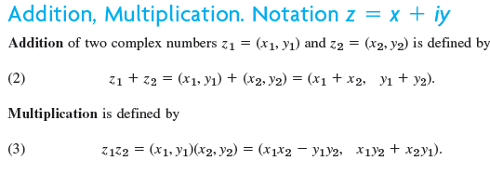

Slide 5
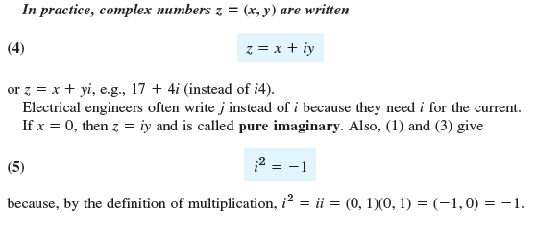

Slide 6



Slide 7
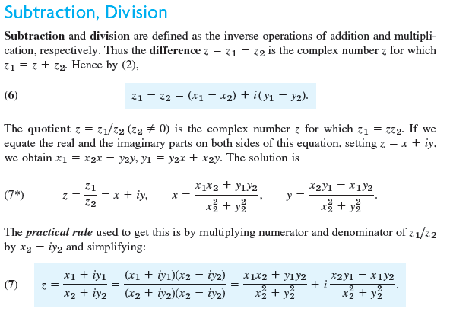

Slide 8



Slide 9
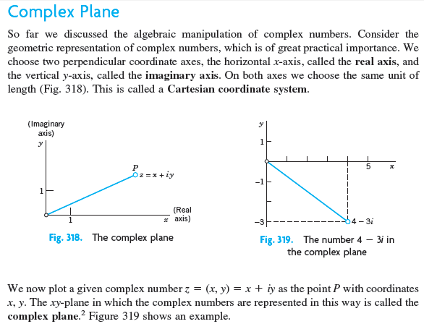

Slide 10
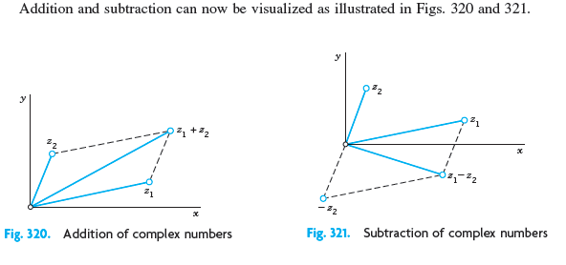

Slide 11
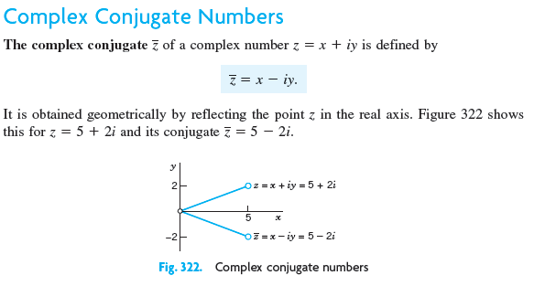

Slide 12
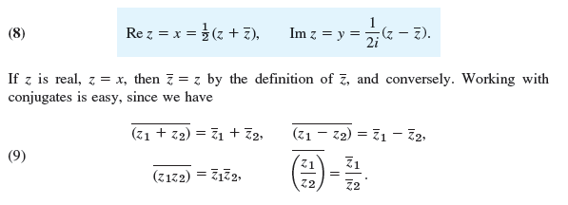

Slide 13


Slide 14
13.2 Polar Form of Complex Numbers. Powers and Roots

Slide 15
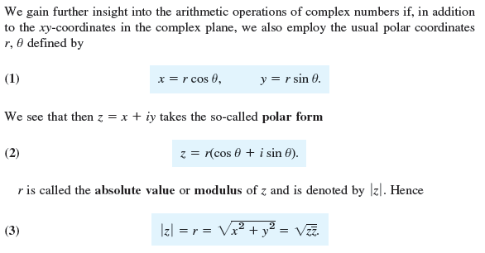

Slide 16
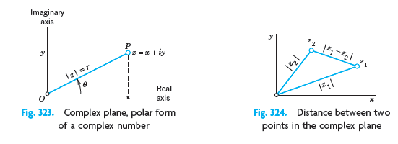

Slide 17


Slide 18
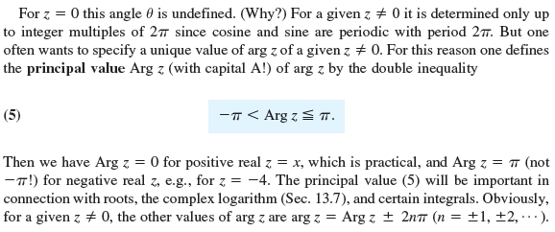

Slide 19


Slide 20
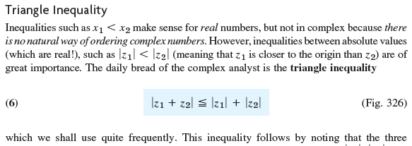


Slide 21


Slide 22






Slide 23



Slide 24

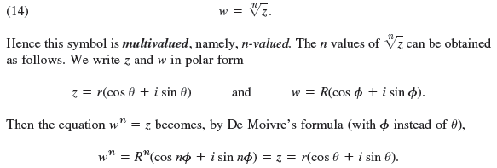

Slide 25
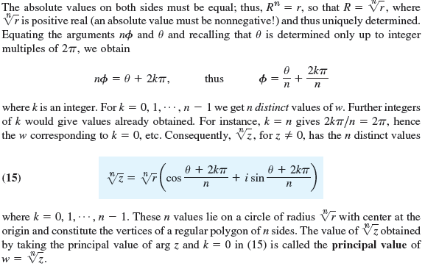

Slide 26
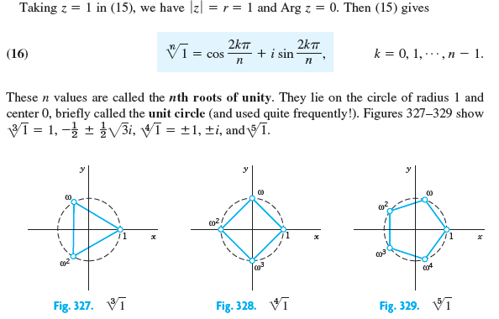

Slide 27
13.3 Derivative. Analytic Function

Slide 28
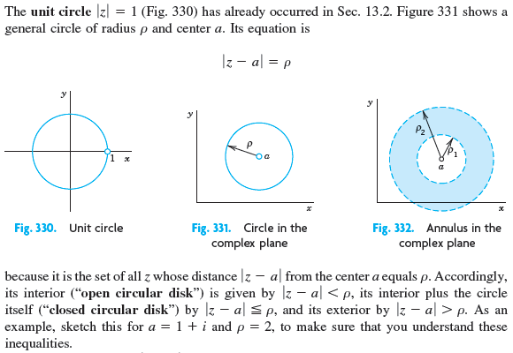

Slide 29



Slide 30
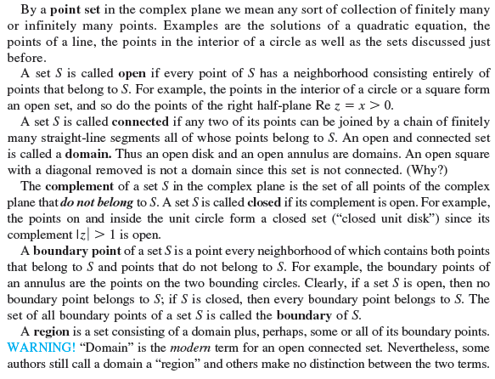

Slide 31
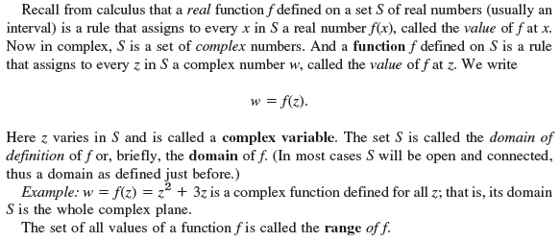


Slide 32


Slide 33


Slide 34
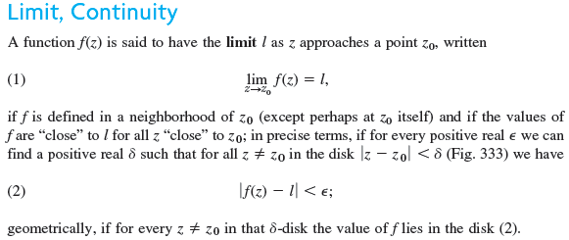

Slide 35
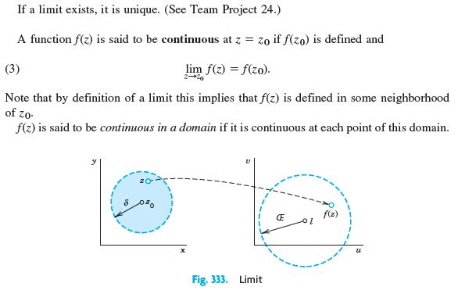

Slide 36
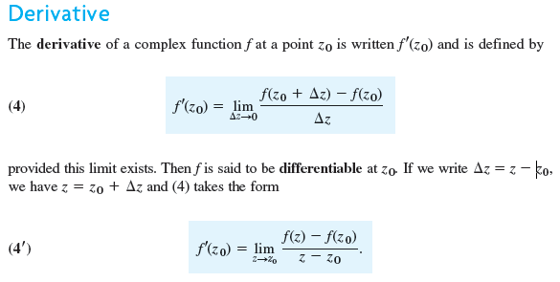

Slide 37


Slide 38


Slide 39
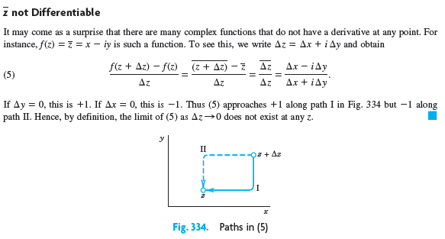

Slide 40


Slide 41
13.4 Cauchy-Riemann Equations. Laplace’s Equation

Slide 42


Slide 43


Slide 44



Slide 45


Slide 46


Slide 47


Slide 48
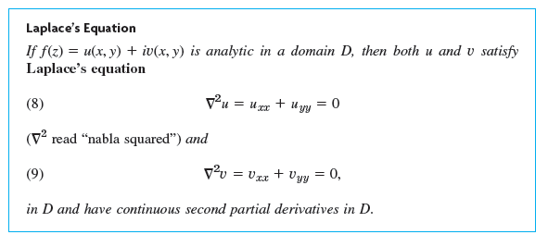

Slide 49
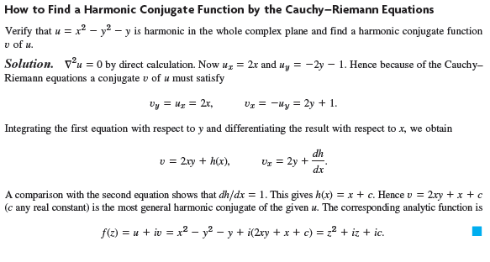

Slide 50
13.5 Exponential Function

Slide 51
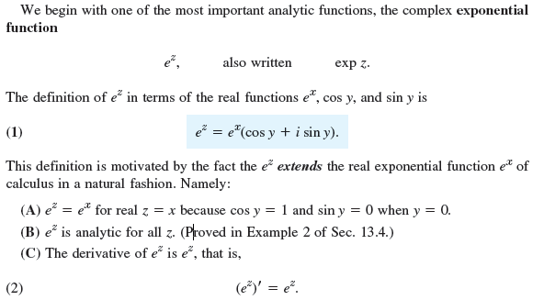

Slide 52
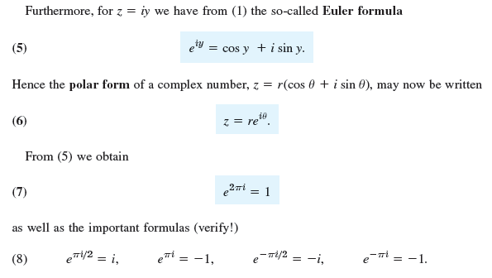

Slide 53
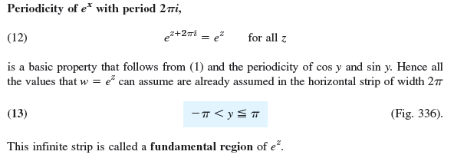
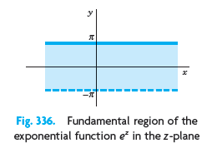

Slide 54
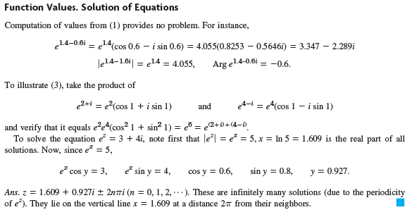


Slide 55
13.6 Trigonometric and Hyperbolic Functions. Euler’s Formula

Slide 56
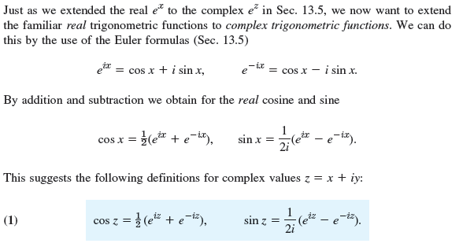



Slide 57
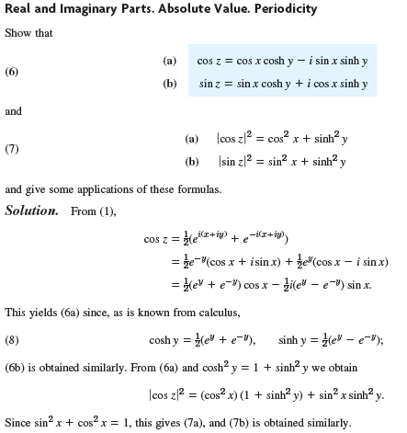

Slide 58



Slide 59
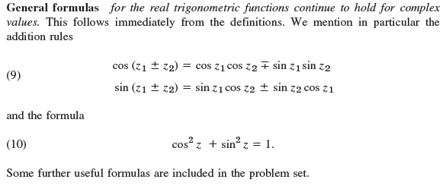

Slide 60



Slide 61
13.7 Logarithm. General Power. Principal Value

Slide 62
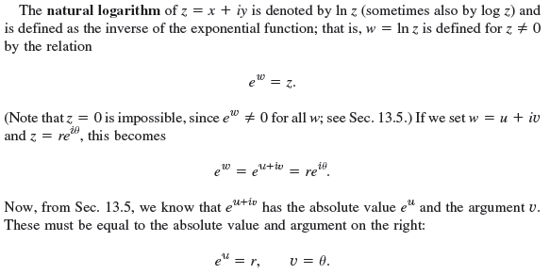


Slide 63
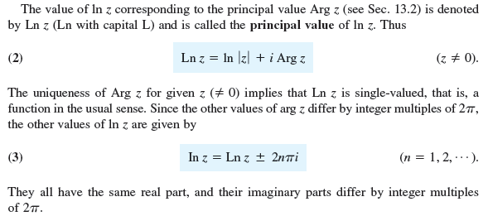

Slide 64


Slide 65



Slide 66


Slide 67
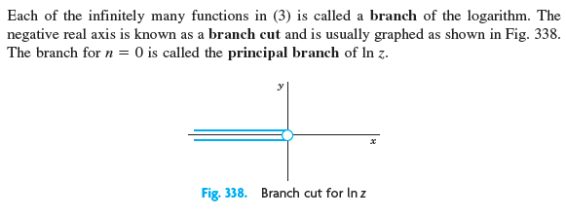

Slide 68
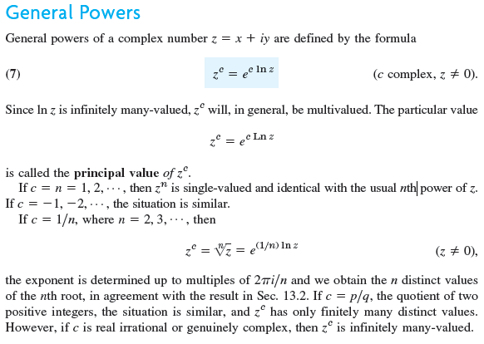

Slide 69



